Slide 1
AsyncTask
Medhat Elmasry

Slide 2
Objectives
Applied
Given a task that takes more than a few seconds to execute, create a new thread to begin executing that task right away.
Given the URL for a file that’s available from the Internet, write the code that downloads the file from the Internet and saves it to the file system of the Android device.
Given data that’s stored in an array, use an adapter to display the data in a ListView widget and to handle the events that occur on this data.

Slide 3
Objectives
Knowledge
Explain why you should use a separate thread for any task that might slow or stop the responsiveness of the UI thread for an Android app.
In general terms, describe how an asynchronous task works.

Slide 4
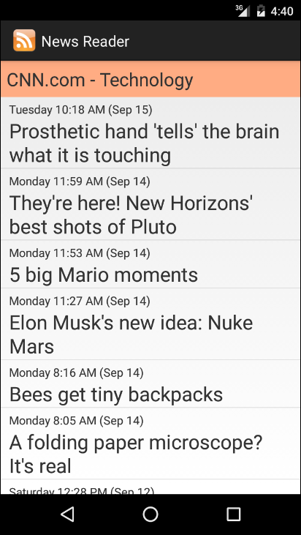
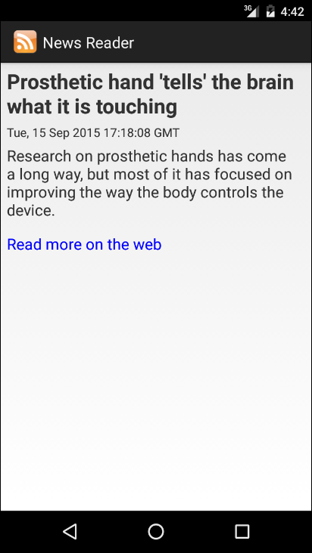
The Items activity
The Item activity

Slide 5
How threads improve UI responsiveness

Slide 6
AsyncTask
AsyncTask enables you to implement MultiThreading without getting your hands dirty with threads.
Performs asynchronous tasks (I.E. operations in the background)
You create an AsyncTask by extending the AsyncTask class and implementing the doInBackground() method. The code in this method runs the background thread
The AsyncTask class also has the onPreExecute() method that runs before doInBackground() and onPostExecute() method that runs afterward.
There is an onProgressUpdate() method if you need to display progress

Slide 7
AsyncTask
Add AsyncTask class as an inner class to the activity that needs to use it.
private class MyAsyncTask extends AsyncTask<Params, Progress, Result> {
protected void onPreExecute() {
// code to run before executing the task
}
protected Result doInBackground(Params... params) {
// code that you want to run in a background thread
}
protected void onProgressUpdate(Progress... values) {
// code that you want to run to publish the progress of your task
}
protected void onPostExecute(Result result) {
// code to run when the task is complete
}
}
This method is optional
This method is also optional

Slide 8
AsyncTask parameters
AsynsTask is defined by three generic parameters:
Params: type of object used to pass any task parameters to the doInBackground() method
Progress: type of object used to indicate task progress
Results: type of task result

Slide 9
AsyncTask
private class MyAsyncTask extends AsyncTask<Params, Progress, Result> {
protected void onPreExecute() {
// code to run before executing the task
}
protected Result doInBackground(Params... params) {
// code that you want to run in a background thread
}
protected void onProgressUpdate(Progress... values) {
// code that you want to run to publish the progress of your task
}
protected void onPostExecute(Result result) {
// code to run when the task is complete
}
}

Slide 10
An activity with a nested AsyncTask class
public class ItemsActivity extends Activity {
private static String URL_STRING = "http://rss.cnn.com/rss/cnn_tech.rss";
@Override
protected void onCreate(Bundle savedInstanceState) {
super.onCreate(savedInstanceState);
setContentView(R.layout.activity_items);
new DownloadFeed().execute(URL_STRING);
}
class DownloadFeed extends AsyncTask<String, Void, String> {
@Override
protected String doInBackground(String... params) {
// get the parameter
String urlString = params[0];
// download the feed and write it to a file
// return a message
return "Feed downloaded";
}
@Override
protected void onPostExecute(String result) {
Context context = ItemsActivity.this;
Toast.makeText(context, result, Toast.LENGTH_LONG).show();
}
}
}
Nested Class

Slide 11
The generic types for the AsyncTask class
AsyncTask<Params, Progress, Result>
Possible class declarations
class DownloadFeed extends AsyncTask<String, Integer, String> {}
class DownloadFeed extends AsyncTask<URL, Void, String> {}
class DownloadFeed extends AsyncTask<Void, Void, Void> {}
class ReadFeed extends AsyncTask<String, Integer, RSSFeed> {}
The AsyncTask class
Method | Is executed…
onPreExecute() | On the UI thread.
doInBackground(Params...) | On the background thread.
onProgressUpdate(Progress...) | On the UI thread.
onPostExecute(Result) | On the UI thread.

Slide 12
The classes for downloading from the Internet
java.net.URL
android.content.Context

Slide 13
How to download a file from the Internet
final String FILENAME = "news_feed.xml";
try {
// get the input stream
URL url = new URL("http://rss.cnn.com/rss/cnn_tech.rss");
InputStream in = url.openStream();
// get the output stream
FileOutputStream out = openFileOutput(FILENAME, Context.MODE_PRIVATE);
// read input and write output
byte[] buffer = new byte[1024];
int bytesRead = in.read(buffer);
while (bytesRead != -1) {
out.write(buffer, 0, bytesRead);
bytesRead = in.read(buffer);
}
out.close();
in.close();
} catch (IOException e) {
Log.e("News reader", e.toString());
}

Slide 14
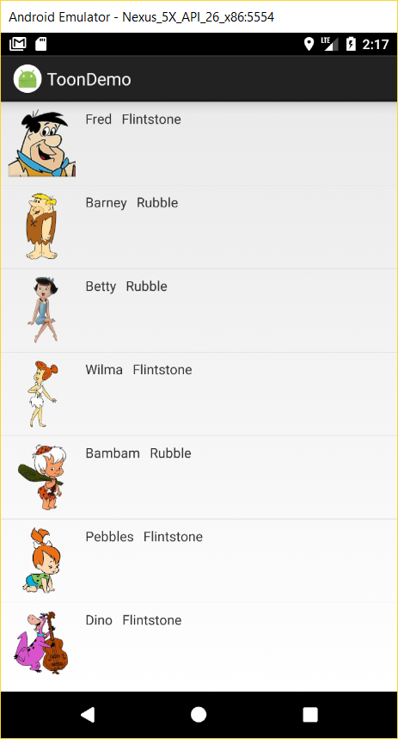
HydratingJsonObjects.docx

